Slide 1
SCREEN SHOT FOR siva

Slide 2
Welcome
Begin with the End in Mind
Notes:
In every slide, ask the audience before you conclude

Slide 3
You can plan for some activity here, if required . Iam not yet decided…

Slide 4
Download attendance

Slide 5
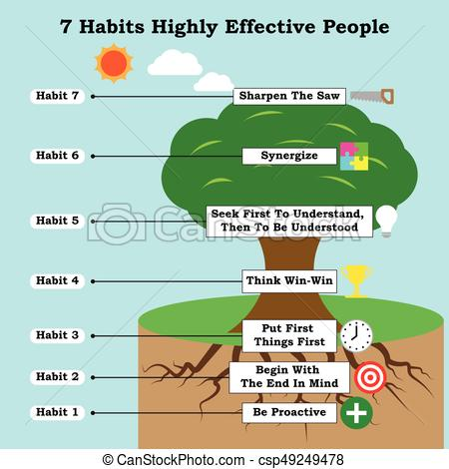


Slide 6
Habit – 1 Be Proactive
Focus Time and Energy on things that can be controlled

Slide 7
Screen shot out time
Attendance

Slide 8
Assignment
SWOT Analysis

Slide 9
First Two Habits
First Habit – Be Proactive
  You are the driver of your Life Vehicle
Second Habit – Begin with the End in Mind
  Fix the destination
  Draw the road map

Slide 10
Simply think beyond today and decide which direction you want to take, then each step will take you in the right direction

Slide 11
Puzzle
If you know the picture, you know how to fix (one glance will give you the full idea, otherwise you don’t know where to start)
Imaging, your life is of 1000 puzzle pieces, imagine the last picture and start solving the puzzle

Slide 12
Begin with the end in mind means
How you would like something to turnout before you get started

Slide 13
Habit-2
Based on Imagination
All things are created twice
  One in the Mind
  Second in the Physical Creation

Slide 14
Begin with the End in Mind means
Begin Each Day , Each Task with the clear vision and direction to desired destination

Slide 15
Examples
Reading a recipe before cooking
Blue print of a House

Slide 16
Begin with the end in Mind means
Have a Plan
Setting Goals

Slide 17
In short
Dream Big-What do you really want to achieve
Be Honest – Where are you now in regard to your goals
Desing a Path : Whats the most direct route from where you are to where you want to be?

Slide 18
In short
Put Pen to Paper : Craft a Mission statement that encompasses your goals, why important, How to Accompalish
Lastly : Complete Commitment

Slide 19
Why this habit?
We may be busy climbing the ladder may be in the wrong wall, every step you take gets you closer to the wrong place faster
Wrong wall : Miss self-respect, miss good friend and relationships

Slide 20
Why this habit?
Otherwise we will endup with empty successes that have come at the expenses of things that were far more valuable to us.

Slide 21
Why this philosophy?
Three valid reasons:
  Clarity
  Efficiency
  Purpose

Slide 22
Clarity – To do and Not to Do eg. Want to live in a beach house, you will not search Job in Delhi
Efficiency – Since you have clarity, you will not waste Time and Energy
Purpose – You can chase your Goals, instead of others Goals

Slide 23
Purpose
Not everybody wants to be rich, many people would rather live a quiet life with the people they love

Slide 24
Activity
Think of something that represents you, a flower, a song, an animal? Why so?

Slide 25
Piece of Advice
You are young, you are free, your whole life is waiting in front of you.
Friends are important to achieve goals, instead of having bad friends, be alone happily
Friends need not be in same age, your grandpa can play the role of a friend verywell

Slide 26
In the cross roads
If you don’t decide the direction, some one will decide on behalf of you

Slide 27
Eg.
For Weight Loss, Begin with the end in Mind,
Keep a picture of your young age
Buy an outfit now it self for the future use (you can wear it after the weight loss)

Slide 28
Goal Setting
SMART Goals
  Specific
  Measurable
  Achievable
  Relevant
  Time Bound

Slide 29
Why Goals?
All victories are having a Deadline / Goals
Any Goal is interesting.
Tough Goal makes the game interesting
Eg. In Cricket, High Target Score makes the game interesting
Try to find the difference between Try and DO

Slide 30
Mission Statement
Make your Life Extraordinary
Write your mission statements for you
Mission statement can be a Quote or Picture or Paragraph or a Photograph

Slide 31
Attendance time

Slide 32
Mission Statement
Mission statement tells you what is important to you.
It is like a tree, its alive, its stable, it grows and it wont go anywhere
Any blocks and Obstacles, your mission statement reminds your purpose of being

Slide 33
Choose..
We are free to choose our paths, but we cant choose the consequences that come with them
Be selective about the people you trust, because so much of your future hangs on whom you hang out with

Slide 34
Choose
Have you ever gone water sliding?
You can choose which slide you want to go down, but once you are sliding, you cant very well stop. You must live with the consequences…to the end.

Slide 35
Your Destiny…
Who will Control your Destiny?
  Friends,
  Parents,
  MEDIA ..
  Can you tell some more…

Slide 36
Activity
List 10 things you love to do

Slide 37
Some piece of advice
Live with the moment, but don’t go with the flow. The river may end up with the falls
Don’t be a dumb sheep…don’t follow some one blindly…

Slide 38
Talents..
Every one is having some or the other talent and they are unique..
what you call it as a talent, sense of humor, good speaker, good organizer, good listener, forgiving , forgetting, or just being nice.
Don’t invent talents, just detect. Michelangelo, after carving a beautiful sculpture, he told that Sculpture was already there in the granite, I just removed the unnecessary parts

Slide 39
What you are good at? Good with numbers, Good with words, Creative thinking, Athletic, Memorising things, Accepting others, speaking, writing, dancing, listening… (type in chat box)

Slide 40
Three watch outs during the journey
Prejudice,
wrong (Negative) labels, If you have been falsely labeled, you can live with it. The real danger comes when you start believe the labels yourself.
Its all over Syndrome, if you fail or make a mistake…don’t think your life is over

Slide 41
During the Journey
Remember life is a mission, not a career, career is a profession, mission is a purpose
A career asks, what is in it for me? , mission asks, How can I make a difference?
Most of us will never do great things, we will do small things in a great way.

Slide 42
Small distractions
Be aware, Small distraction can make a huge destination differences. New York to Tel Aviv Israel, One degree change by Pilot towards north end up in landing Moscow, Russia

Slide 43
Baby Steps to Practice
1. What are the three most important skills you need for your career?
2. Mission statement reread
3. Current cross road, what is the next path?
4. Write your goals
5. Negative labels.

Slide 44

Mission statement examples

Slide 45


Slide 46
Attendance time

Slide 47
“To inspire positive change through teaching and coaching.”
To create opportunities for today's youth.”
“To encourage, engage, and equip others to believe in the possibilities.”
“To positively impact the life of every person I meet.

Slide 48
Screen shot out time
Attendance

